Slide 1

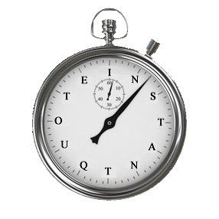
Still spending time on quotes?

Slide 2
We automate your business
Automatic Quotations
Online Card Payments
Bookings Management
Automatic Customer Revues
This is no One size fits all solution
Based on YOUR business model
Built by industry experts
Low in cost, high in features
Proven solution
Sending £1m of quotes / month

Slide 3
So you can manage it
It’s at your fingertips!
Booking information
Payments Due
Year on Year Comparison
Performance Graphs
Marketing data
Financial statement
Reporting
Marketing
Finance

Slide 4
Share Cars on multiple websites
Instant Quote
Your Website
Agency Website
Directory Website
Just one configuration
Share availability
Share photos
Send Quotes
Publish Reviews
Maintain Control

Slide 5
 | Agency Pays | Directory only | Free Plan | Paid Plans
Free of charge | ☑ | ☑ | ☑ † | ☒
Quote page on your website | ☒ | ☑†† | ☑ | ☑
Accept card payments online | ☑ | ☑ | ☑ | ☑
Customer My booking page | ☑ | ☑ | ☑ | ☑
Directory micro website | ☑ | ☑ | ☑ | ☑
Manage bookings / reviews | ☑ | ☑ | ☑ | ☑
Facebook application | ☒ | ☑ | ☑ | ☑
Syndicate to agency | ☑ | ☒ | ☑ | ☑
† Limits apply - then there is a cost
†† 3 quotes / item every 30 days from any quote page

Slide 6
Run your business
Don’t let your business run you

Slide 7
www.instant-quote.co

